Slide 1
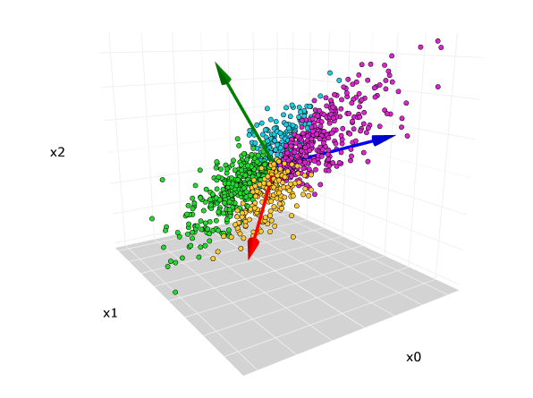
Principal Component Analysis

Slide 2
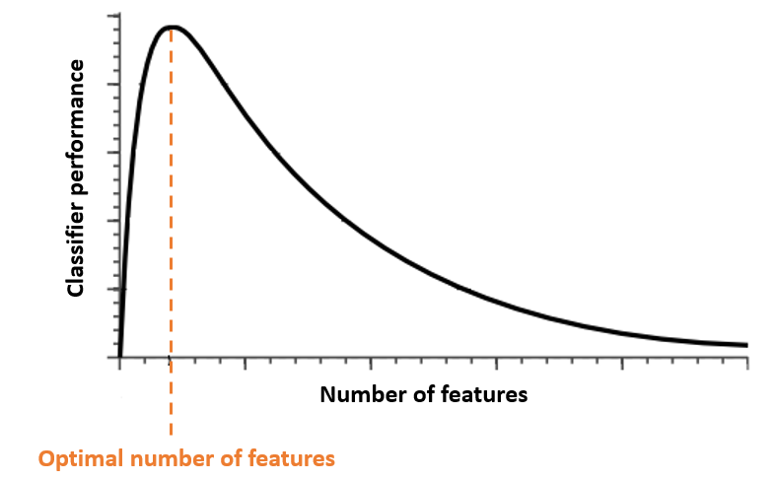
Curse of Dimensionality!
As the dimensionality increases, the number of data points required for good performance of any machine learning algorithm increases exponentially.
The reason is that, we would need more number of data points any given combination of features, for any machine learning model to be valid.

Slide 3
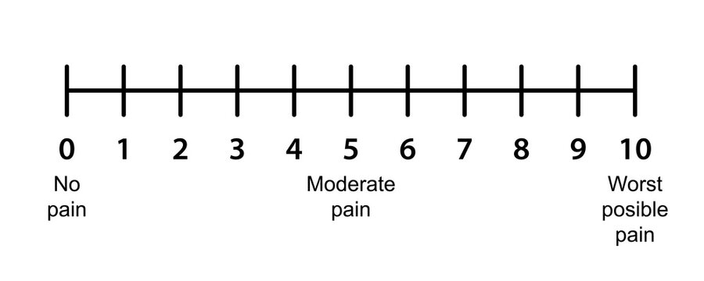



Understanding the dimensions of datasets
Column 1
10
8
9.5
9.2
2
3
1
1.5
3.5
For 1D (1 column, it’s very easy to represent the entire dataset with the help of one axis.
We can clearly see that there are 2 groups(clusters) are visible.

Slide 4
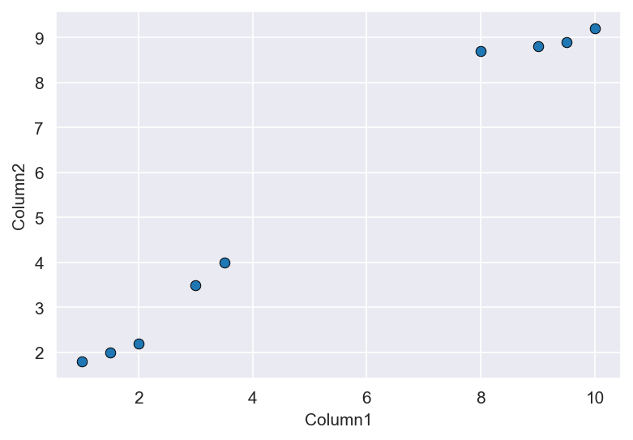
Column1 | Column 2
10 | 9.2
8 | 8.7
9.5 | 8.9
9 | 8.8
2 | 2.2
3 | 3.5
1 | 1.8
1.5 | 2
3.5 | 4

Slide 5
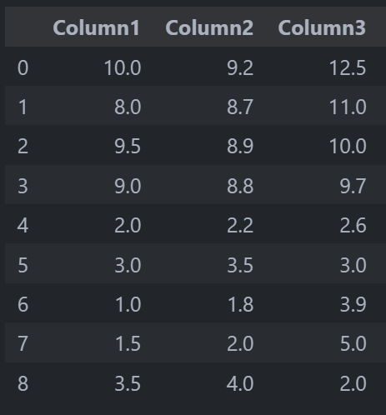
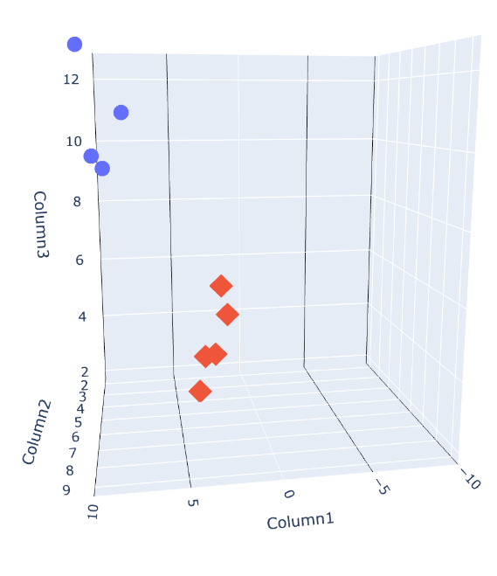
If we have 3 columns, we can still understand the data pretty accurately.
In this graph, we have 2 classes.
But what if we have more than 3 columns?

Slide 6
Applications of PCA:
PCA is used to convert the higher dimensional dataset into lower dimensions by capturing higher amount of information.
PCA is also used to remove the multicollinearity problem from the dataset.
PCA is a linear orthogonal transformation, that transforms the data to a new coordinate system.
It generates several principal components which have captured the huge information from original dataset.!
As we reduce the number of columns, it also allows to visualize HD data into LD.

Slide 7
Working of PCA
There are several steps PCA involves:
Step 1. Standardization
Step 2: Calculate Covariance Matrix of data
Step 3: Calculate Eigen values and Eigen Vectors
Step 4: Projection of data points on various PC’s
Step 5: Generate PC’s

Slide 9
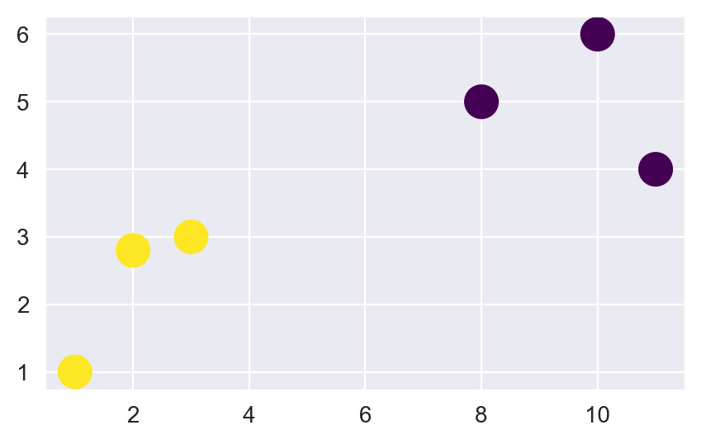
Understanding the PCA
Let’s say we have to convert
this data into
Lower dimensions.
First step is STANDARDIZATION

Slide 10
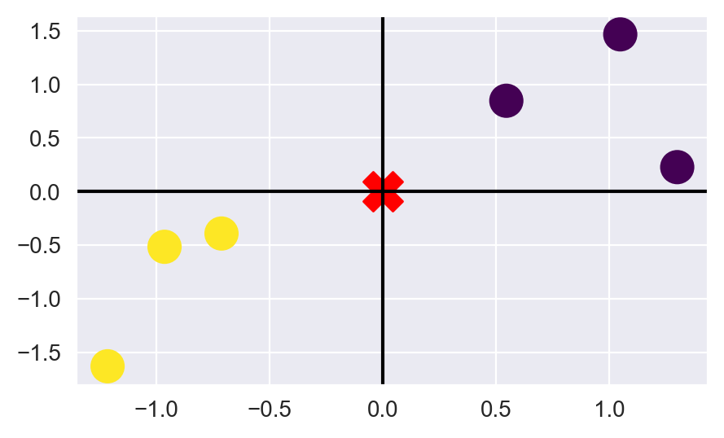

Slide 11
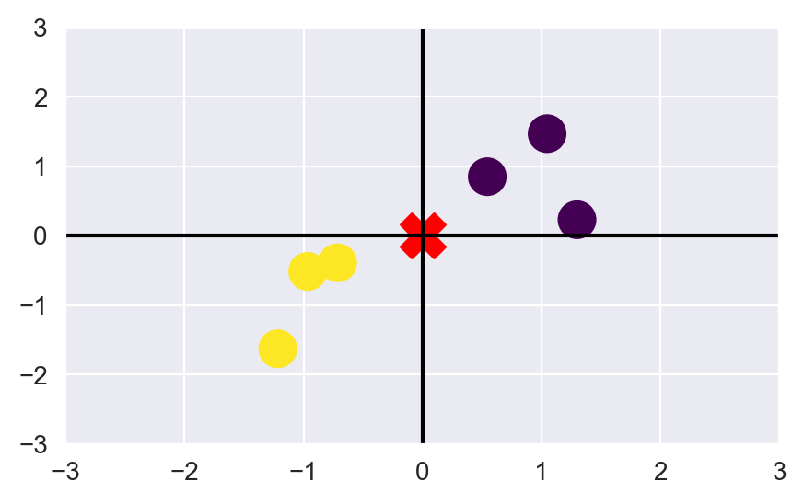
d1
d2
d3
d5
d4
d6

Slide 12
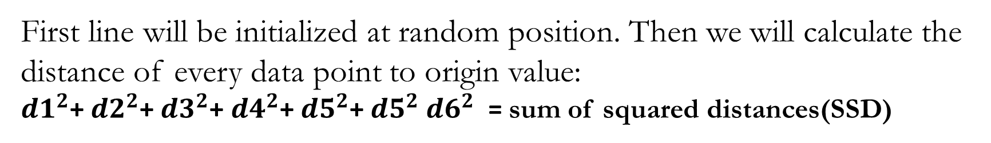
First line will be initialized at random position. Then we will calculate the distance of every data point to origin value:
${d1}^{2}$+ ${d2}^{2}$+ ${d3}^{2}$+ ${d4}^{2}$+ ${d5}^{2}$+ ${d5}^{2}$ ${d6}^{2}$ = sum of squared distances(SSD)

Slide 13
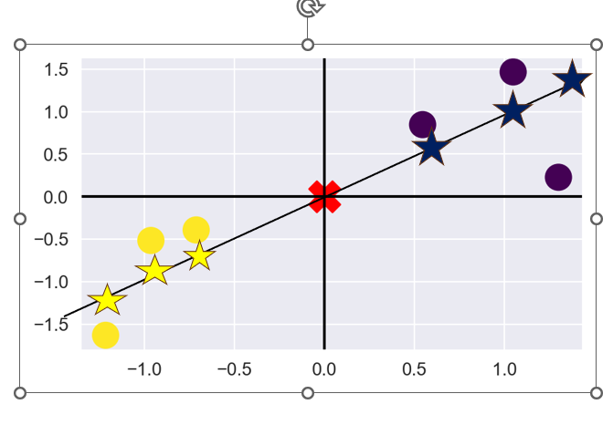
Once, we generate PC1, PC2 will always be perpendicular to PC1.

Slide 14
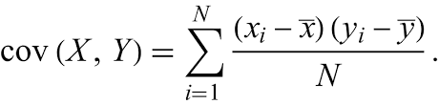
COVARIANCE
Covariance is a statistical measure that quantifies the degree to which two random variables change together. In other words, it measures the extent to which two variables are linearly related. It's often used in statistics and data analysis to understand the relationship between two variables and how they tend to move in relation to each other. Here's how covariance works:
Positive Covariance: If the covariance between two variables is positive, they move in the same direction. When one goes up, the other tends to go up as well.
Negative Covariance: If the covariance is negative, They move in opposite directions. When one goes up, the other tends to go down.
Zero Covariance: A covariance of zero indicates that there is no linear relationship between the two variables. They are statistically independent of each other, and changes in one variable do not provide information about changes in the other.

Slide 15
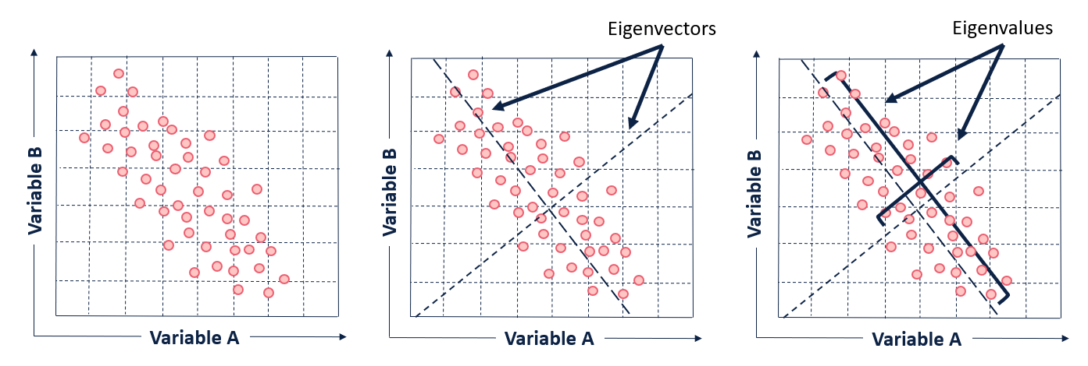
Role of Eigen Value and Eigen Vectors in PCA

Slide 16
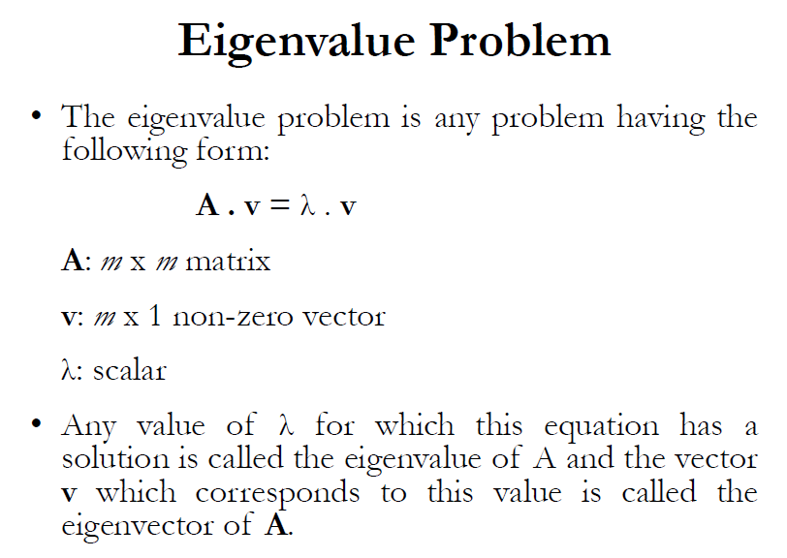

Slide 17
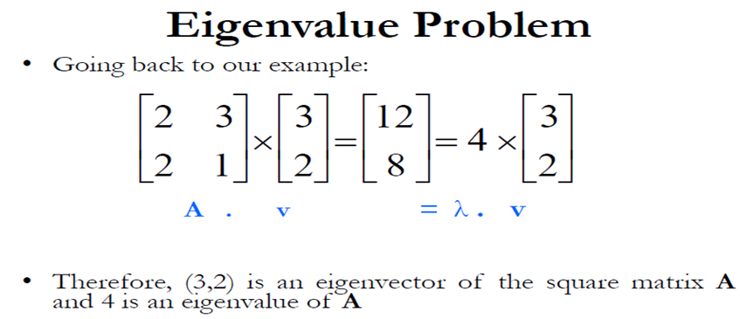

Slide 18
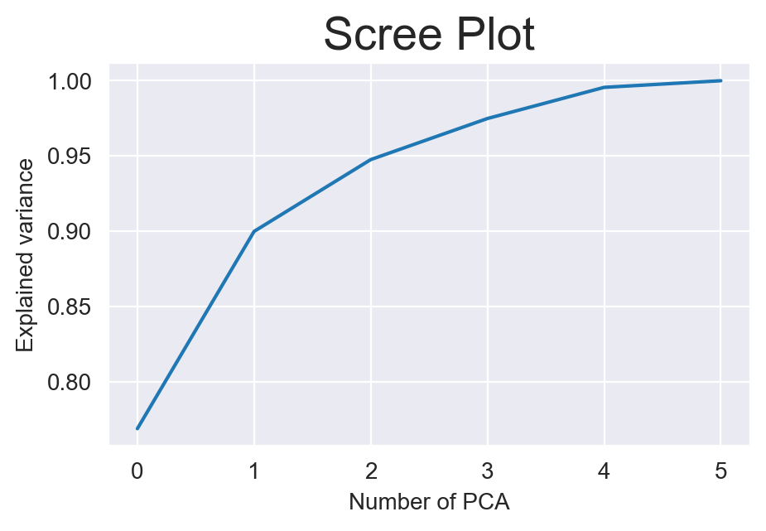
Scree Plot
PCA will generate those many principal components which is equal to number of columns.
Out of all PC’S, we have to select those principal components which have captured maximum variance.
For this, we use scree plot.

Slide 19
Thank You

